Slide 1
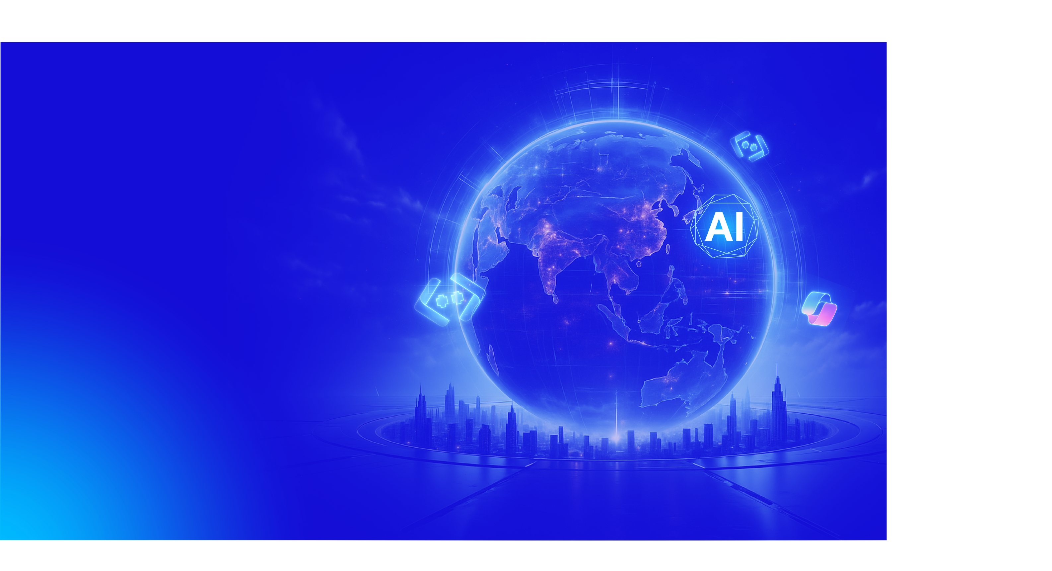
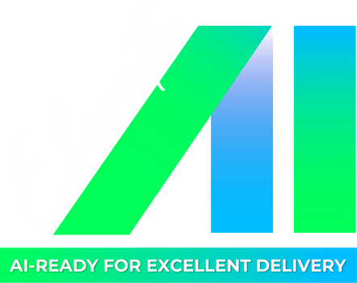

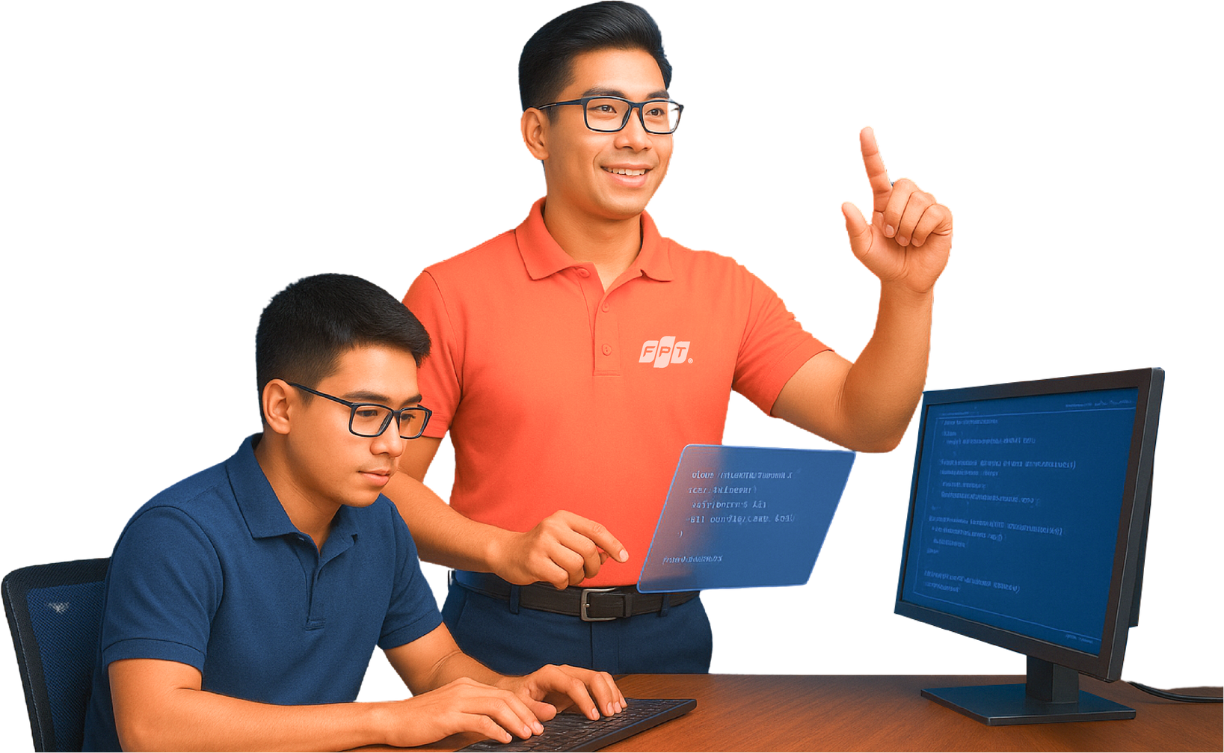
🚀 Workshop 3: Building a Chatbot System Using ChromaDB, OpenAI SDK, HuggingFace Text-to -Speech
Date

Slide 2

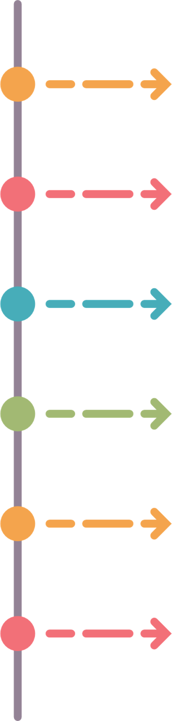
📋 Timelines
9:00 – 9:10
Stabilize seats for Trainees, take attendance
9:10 – 9:30
Share artifact files with Trainees . Describes the problem statement, deployment format, desired output.
09:30 – 12:00
Trainees: Discuss and implement Submit all to SharePoint
Trainer: Rotate multiple groups to support
12:00 – 13:00
Lunch Break
13:00 – 15:50
Presentation
15:50 – 16:00
Workshop Summary
7

Slide 3
🎯 Workshop Objective
Build a chatbot system that integrates all these technologies
What you'll learn:
🔗 Integrate Azure OpenAI's API with Python code
⚡ Automate text generation, summarization, or other processes
🤖 Build useful assistants for various tasks
📝 Handle prompts effectively
3

Slide 4

💼 Application Options
Choose One or Define Your Own:
🎧 Customer Support
Responds to queries and speaks answers aloud
📚 Educational Tutor
Answers student questions with audible explanations
🎬 Entertainment Recommender
Suggests movies/shows with spoken recommendations
🌍 Language Learning Assistant
Helps learning with responses in target language
4

Slide 5
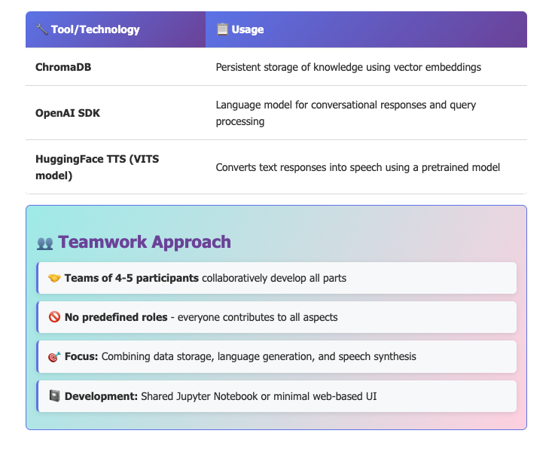
🛠️ AI Tools Usage Guidelines
5

Slide 6

🎁 Deliverables by End of Workshop
🗄️ ChromaDB Implementation - storing mock data (user queries, FAQs, knowledge base)
🔊 HuggingFace TTS - converting responses into spoken audio
💻 Working codebase with a simple interface (CLI or web)
📝 Tested conversation logs demonstrating multi-turn interaction
🎤 Team presentation with demo, insights, and lessons learned
6

Slide 7


THANK YOU!
🎉 Ready to Build Amazing AI Tools?
Let's turn your repetitive tasks into automated solutions!
8

